Slide 1



Overcome Development Challenges through Visualization Dashboards
DATA ETHICS PH
An Entry for Bangsamoro Data Challenge
by Amistad, Adam and dela Cruz, Karlo

Slide 2
Outline
Introduction
Motivation
Dashboard
Notes:
Notes:
I’d talk to you about –
Assignment:
(insert pagoda pictures in the airport)

Slide 3
Introduction
Our Team

Slide 4


Our Team
Adam
Senior Data Analyst
Karlo
Data Scientist

Slide 5
Outline
Introduction
Motivation
Dashboard

Slide 6
Motivation
Development Challenges
Solution

Slide 7
Bangsamoro
The Bangsamoro Organic Law or BOL (Republic Act No. 11054) provides for the creation of the Bangsamoro Autonomous Region in Muslim Mindanao (BARMM), and it covers the provinces of Basilan, Lanao del Sur, Maguindanao, Sulu, and Tawi-Tawi, the same provinces as ARMM.
Will the BOL usher the start of poverty reduction in the region?

Slide 8
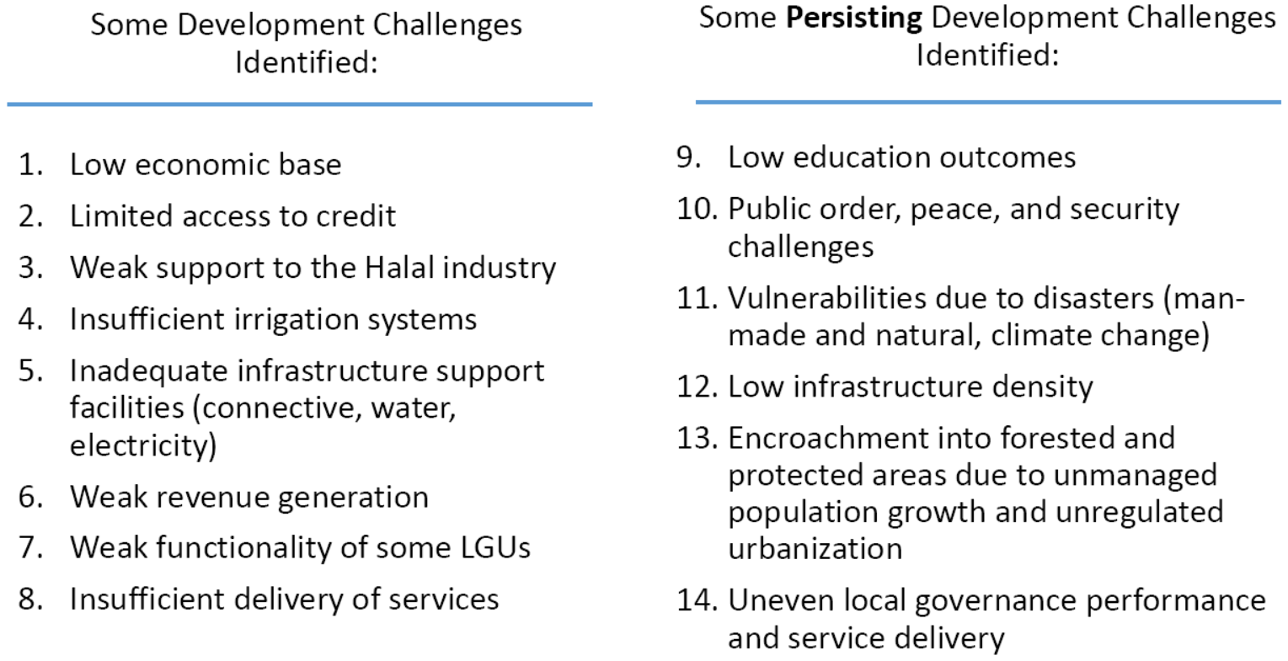
Bangsamoro Challenges
-based from Datathon Session 2

Slide 9


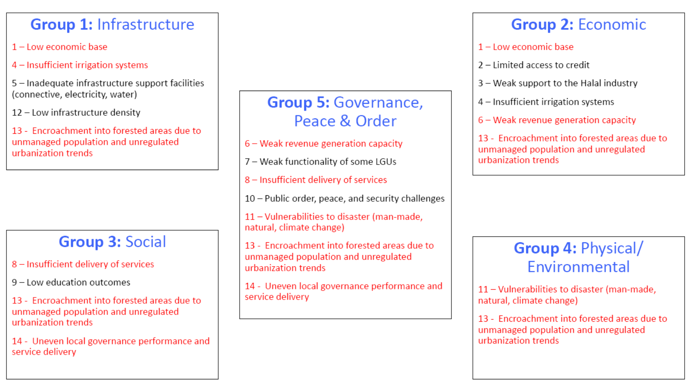



Bangsamoro Challenges
Current Development Challenges are Grouped into these Categories

Slide 10


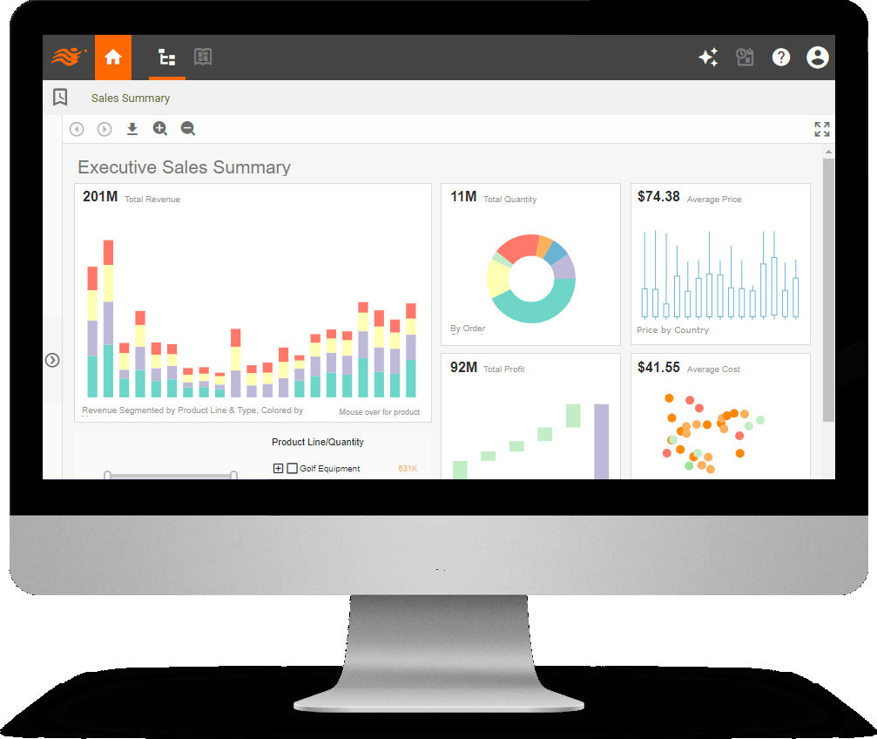

Solution
Develop Generation Visualization Dashboard that address current development challenges for Bangsamoro Region.
“Proper Governance Guided by Data”

Slide 11
Outline
Introduction
Motivation
Dashboard

Slide 12
Dashboard
Visualization Dashboard - Education
Sources
Note

Slide 13
Visualization Dashboard
Education
This Dashboard address social concerns on low education outcomes in Bangsamoro region. Using the spatial and school data, the dashboard presents the current progress of education in the region.
This Dashboard guides LGUs on how to mitigate problem in Public Education, such as building schools at the right location, hire right number of teachers, etc.

Slide 14
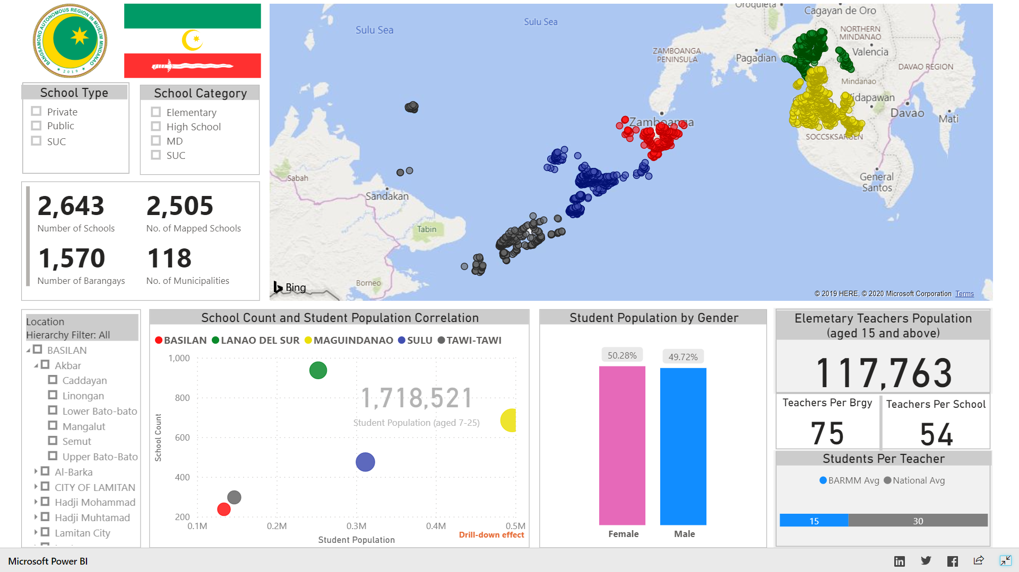

Slide 15
Sources
https://app.powerbi.com/view?r=eyJrIjoiNzRkZTA2ZmQtMWQ4NS00YmE5LTllZGUtZGI1MzU0Mzc1YTk2IiwidCI6ImE2NTFlM2M3LTU1M2ItNGNmNy05Y2I3LTFlMDZjYjQ0MWIwYSIsImMiOjEwfQ%3D%3D
Notes:
Predict Aircraft, Cargo Freight and Passenger Movement
Apply forecasting techniques for Best Business Decision
Save Billion of Pesos with Effective Cost-Cutting Strategy

Slide 16
Note
Given a Chance to be Selected, we can expand our topic on other development challenges, such as Infrastructure, Peace & Order, Economic and Environmental.

Slide 17
An Entry for Bangsamoro Data Challenge
DATA ETHICS PH
END

